Slide 1


Poster Guidelines
Update
Notes:
Updated 8-18-15, 2015

Slide 2
Original ASG Goals
Clean up campus by reducing clutter of posters/fliers and blue tape usage.
Partner with signage committee to
re-evaluate current posting guidelines.
Partner with brand manager to encourage proper logo usage and approval policies.

Slide 3

Results
We are ending the use of blue tape
Poster Guidelines have been revised
25 copy limit

Slide 5
What’s New in Guidelines
Posting allowed on bulletin boards only at all 3 campuses. No doors, walls or windows.
13 new bulletin boards have been installed around campus.
Proof of brand review required.

Slide 6
Key Reminders
All posters featuring the CCC logo or mascot must be reviewed for brand compliance prior to printing. Send pdf to BrandReview@clackamas.edu.
Don’t use tape or staples. Tacks available on boards and ASG desk.
Ask permission before posting on department maintained boards.

Slide 7
Bulletin Board Markings (ASG maintained)

Slide 8
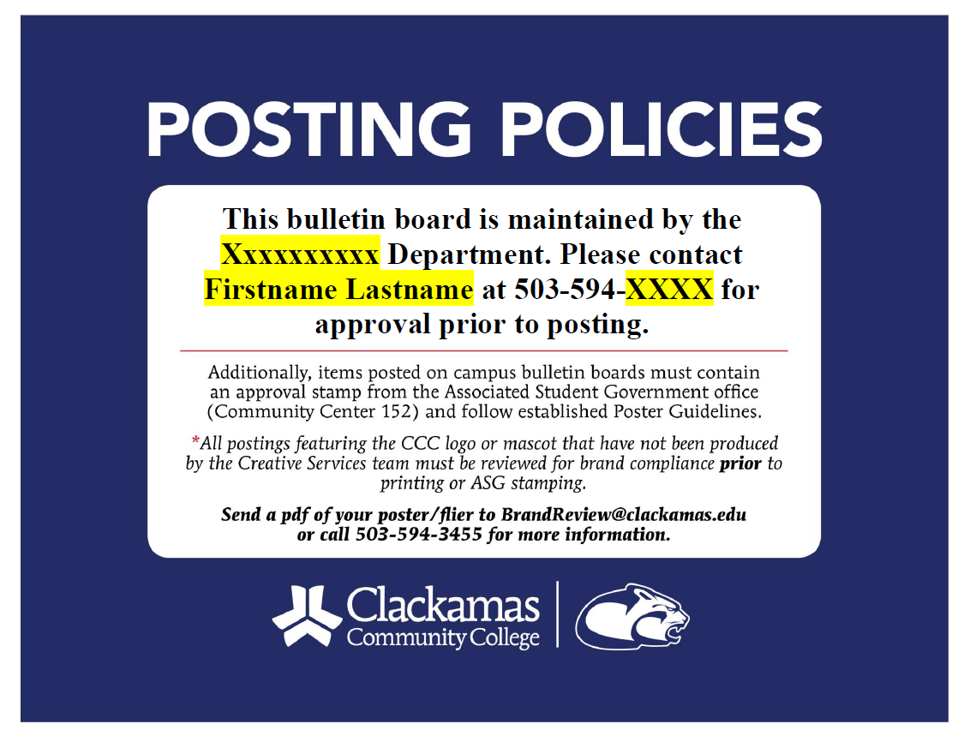
Bulletin Board Markings (Department maintained)
Editable Word template available soon in Brand Toolbox.

Slide 9
3 most common logo / mascot usage mistakes…

Slide 10
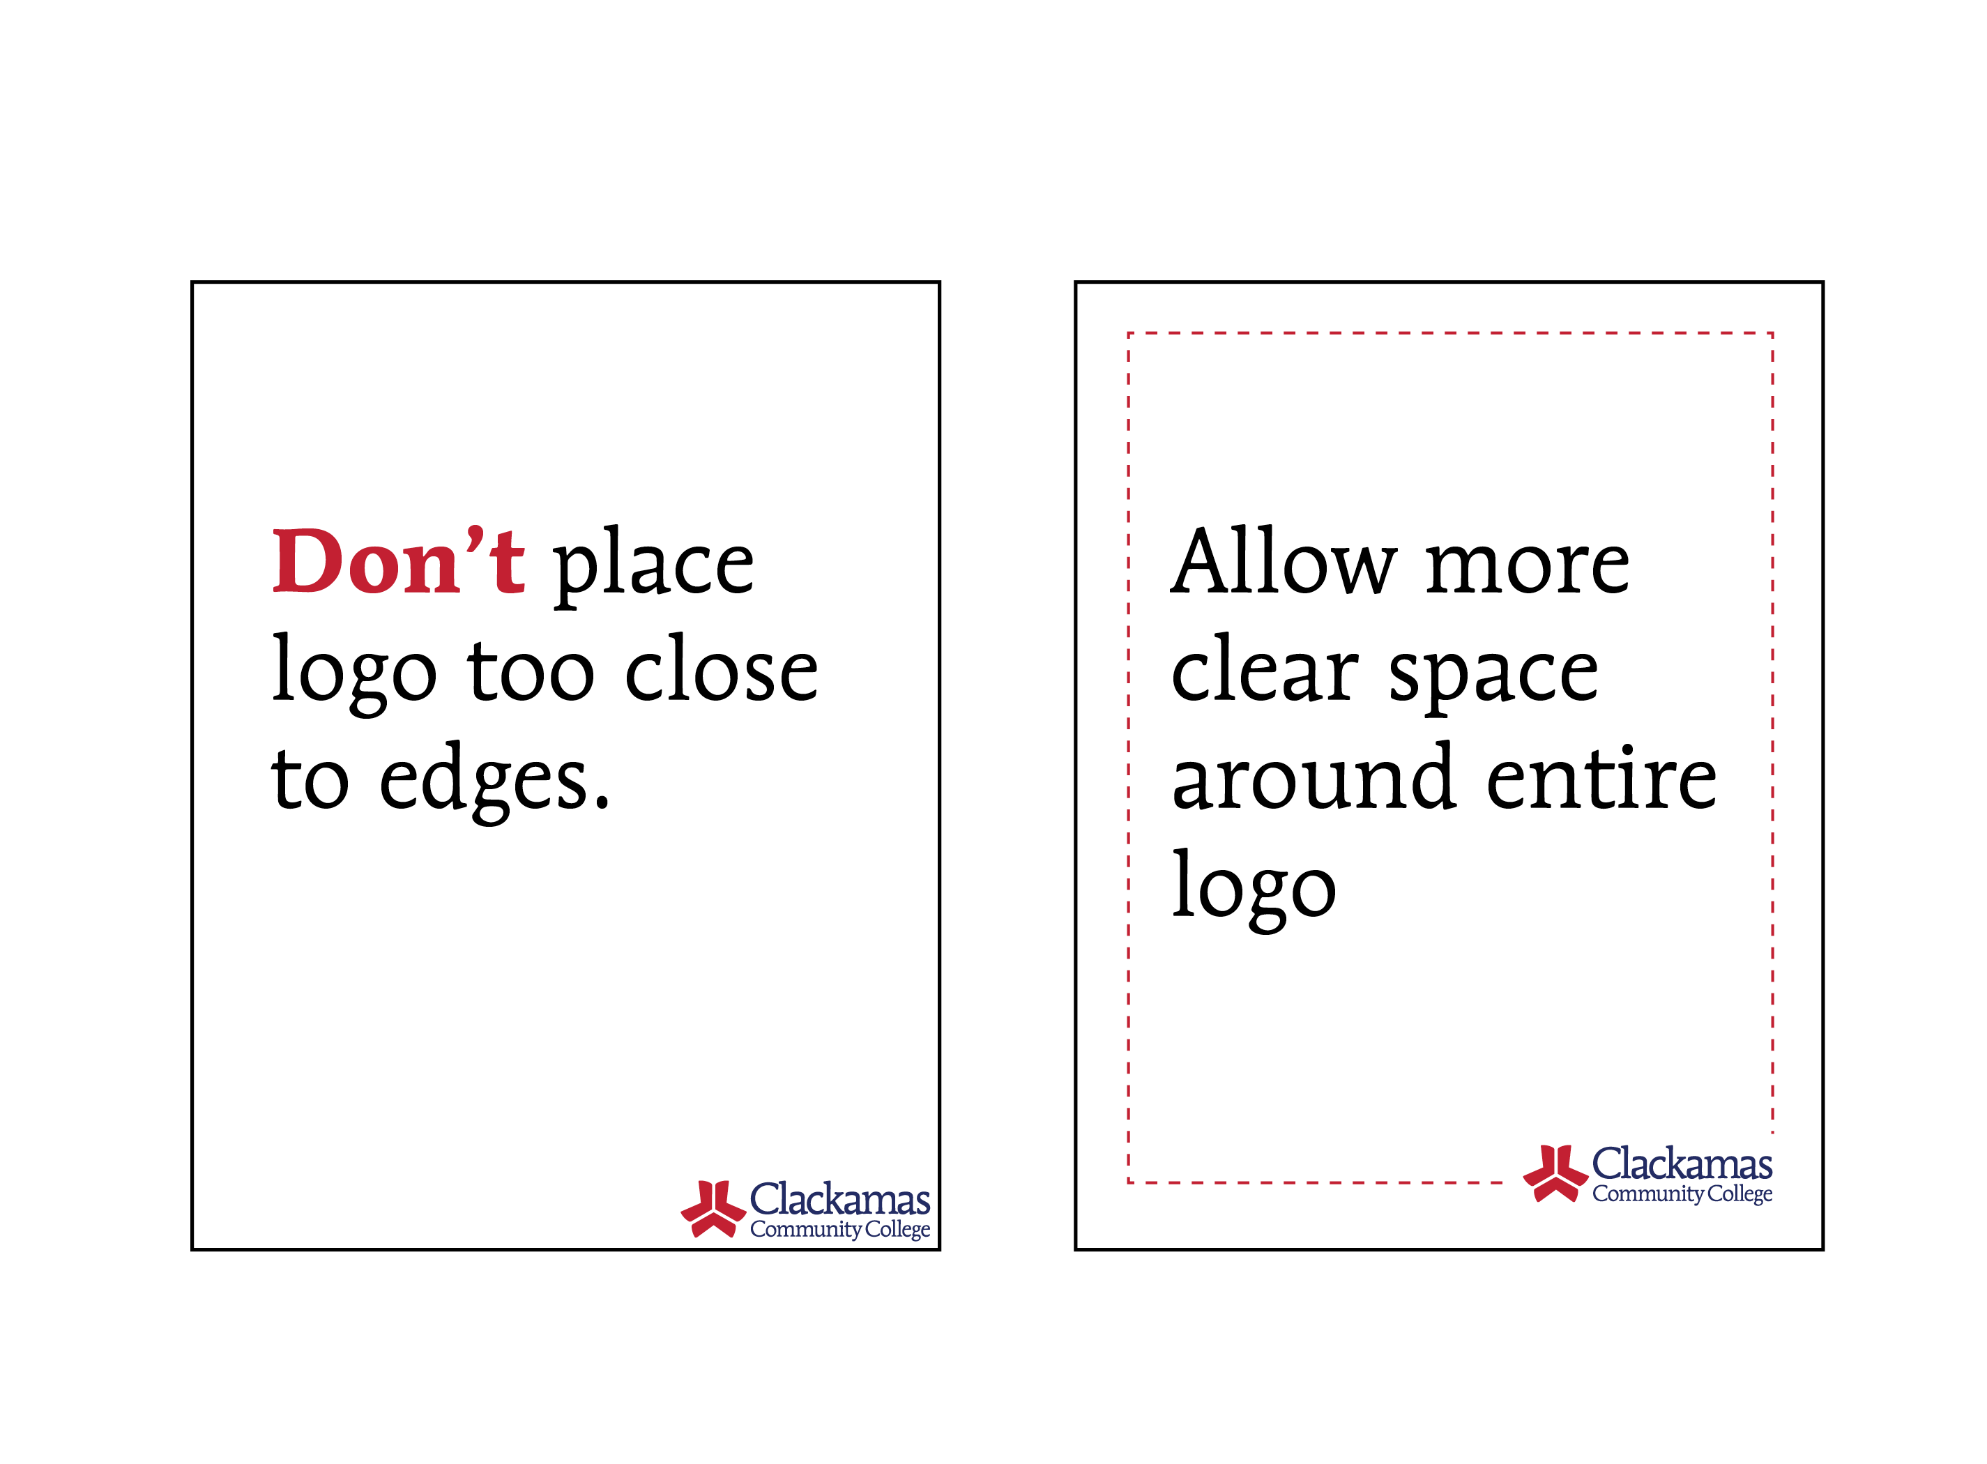

Slide 11
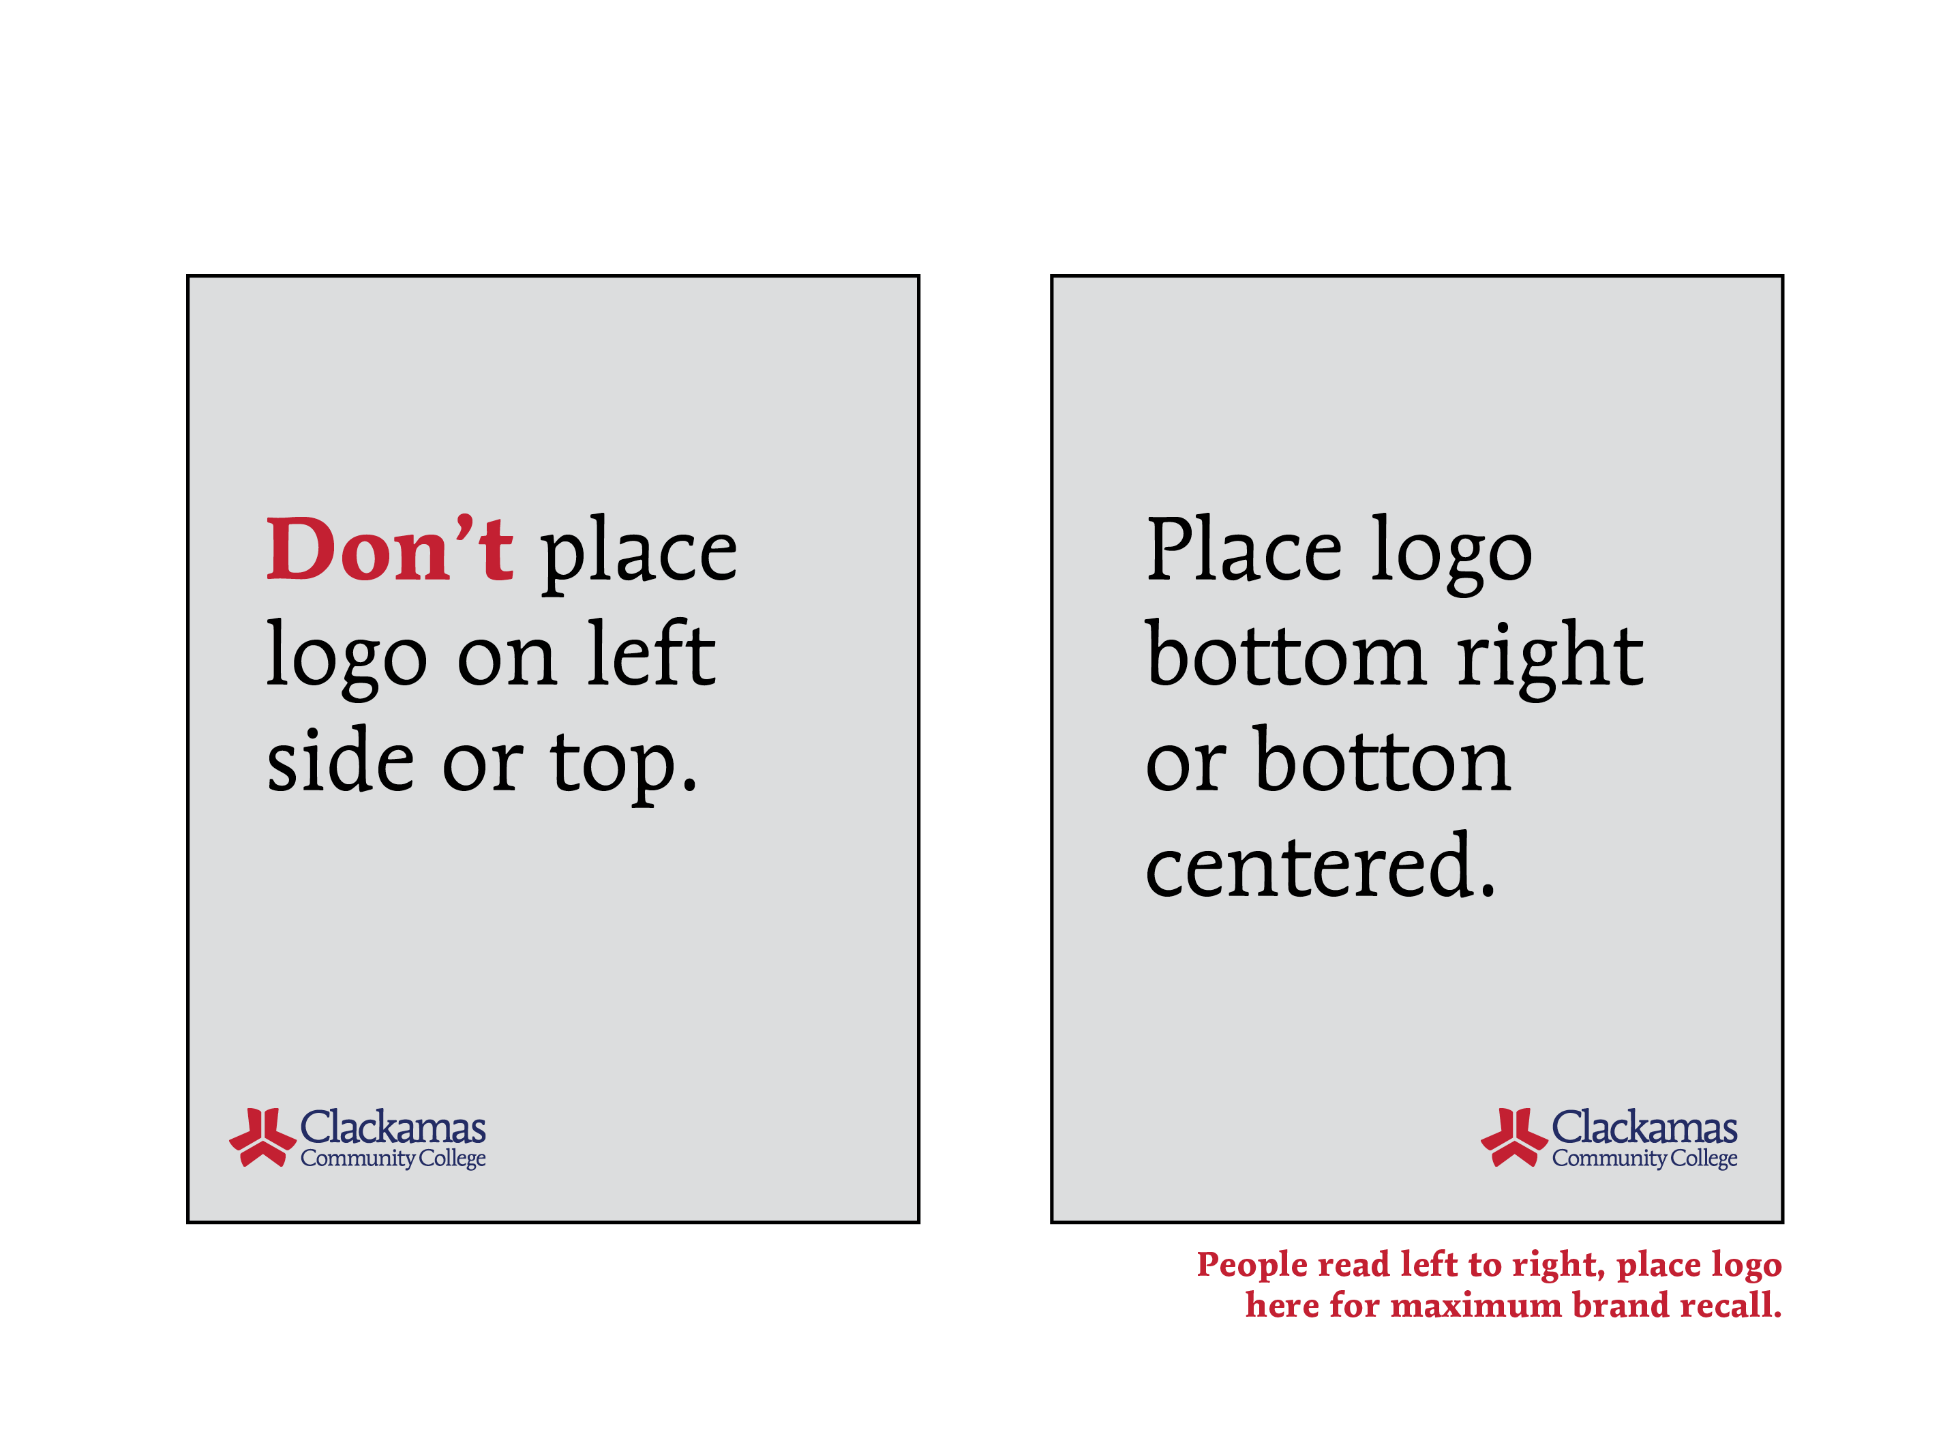

Slide 12
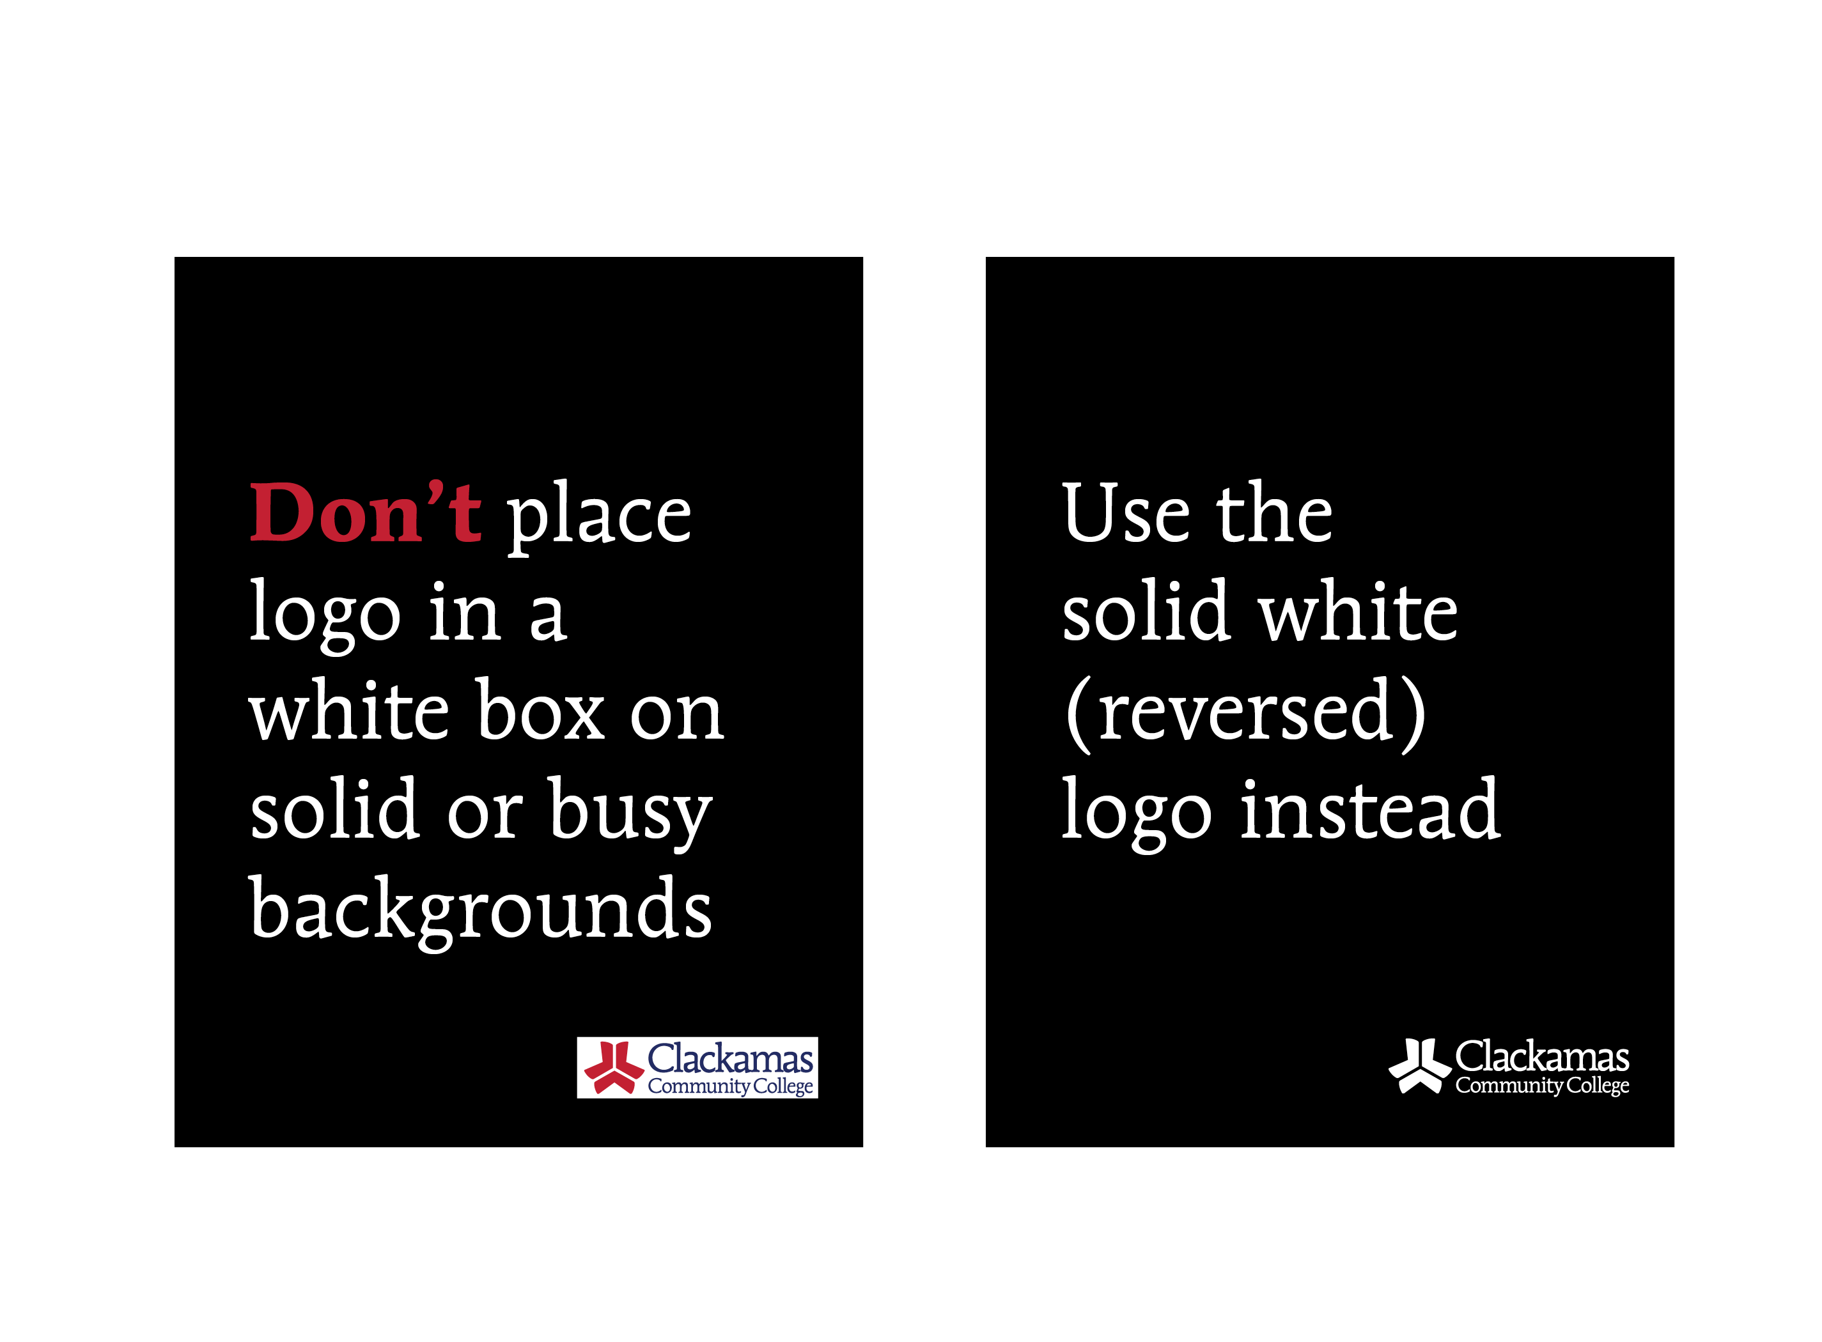

Slide 13
What’s next?
Poster guidelines will be printed and available soon at ASG desk and in Brand Toolbox.
Begin phasing out posting on walls, doors and windows. No blue tape handed out.
Poster policies will be marked on all bulletin boards.
Begin requiring proof of brand review if CCC logo or mascot is used on poster.
Identify additional bulletin board needs/locations.

Slide 14
Questions

